Slide 1


COMSATS University Islamabad,
Attock Campus

Slide 2

HEART DISEASE PREDICTION USING MACHINE LEARNING
Supervised by:
Miss. Farrah Khan
Presented By:
Syed Yaish Ali
Farhan Khan
FA22-BAI-043
FA22-BAI-003
Presented on 13th June 2025
Department of Computer Science
COMSATS University Islamabad, Attock Campus

Slide 3
Outline
_______________________________
Abstract
Introduction
Literature Review
Methodology
Results
Conclusion
References
_______________________________

Slide 4

Abstract
_______________________________
This research delves into the pivotal role of machine learning in predicting potential heart conditions in humans, emphasizing its significance in healthcare. Evaluating the performance of diverse classifiers, including Decision Tree, Naive Bayes, Logistic Regression, SVM, and Random Forest, the study aims to provide healthcare professionals with advanced insights for tailored patient diagnosis and treatment. Additionally, the proposal of an ensemble classifier, amalgamating the strengths of both strong and weak classifiers, offers a promising avenue for improved predictive accuracy by leveraging a substantial number of training and validation samples. By addressing locomotor abnormalities and heart ailments, this research contributes to the advancement of machine learning applications in healthcare, fostering more precise and personalized medical interventions.
_______________________________

Slide 5
Introduction
_______________________________
The human heart, a life-sustaining maestro, faces a global surge in ailments driven by lifestyle changes, stress, and poor diets.
According to WHO rate in Pakistan 193 and ranked on 30 Disease (CHD) and death per 100000 people.
According to the most recent WHO data on heart attack ratio in Pakistan, 240,720 people died from coronary heart disease in Pakistan in 2020
Machine learning techniques offer hope by leveraging extensive health data for precise predictions.
Information technology's integration aids medical decision-making.
Instrumental in disease management, medication practices, and identifying patterns within diagnostic data.
Traditional risk prediction methods exhibit limitations.
Machine learning leverages complex risk factor interactions, enhancing accuracy in cardiovascular risk prediction.
Exploring sophisticated technologies holds the potential to revolutionize cardiovascular healthcare.
_______________________________

Slide 6
Literature Review
_______________________________
Driven a surge in research focused on leveraging Machine Learning (ML) techniques for accurate prediction and early intervention.
Emphasizes ML's pivotal role in healthcare, specifically in predicting potential heart conditions.
Delves into diverse classifiers: Decision Tree, Naive Bayes, Logistic Regression, SVM, and Random Forest.
Proposes an ensemble classifier amalgamating strong and weak classifiers for improved predictive accuracy.
Stresses the importance of early automatic diagnosis of heart disease using data mining techniques.
Incorporates various medical attributes, such as blood sugar and heart rate.
Practical application demonstrated using WEKA software.
Presents a Hybrid Random Forest Linear Method (HRFLM) for heart disease prediction.
Combines Random Forest (RF) and Linear methods, achieving better results than traditional algorithms.
Proposes a system based on linear Support Vector Machines (SVM) with L1 and L2 regularization.
______________________________

Slide 7
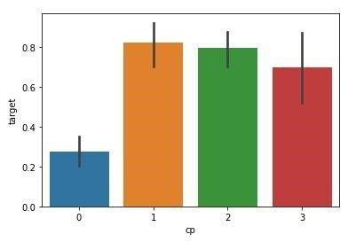
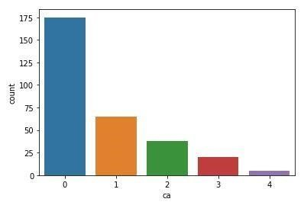
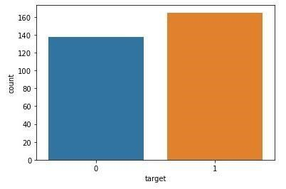
Proposed Methodology
_______________________________
Blood pressure, chest pain, ECG results, etc.
Merged data from varied sources.
Formatted complex data for effective analysis.
Split data for rigorous evaluation.
Percentage of Female Patients:31.68%
Percentage of Male Patients:68.32%
Accuracy scores benchmarked against existing studies.
Considered independence assumptions, potential for over classification, and sensitivity to noisy features.
Slower predictions in ensemble approach but excels in handling missing values.
Precision in heart-related condition prediction.
Percentage of patience without heart problems: 45.54%
Percentage of patience with heart problems: 54.46%
Target: Male:1, Female: 0
Advances healthcare applications.
Demonstrated competitive standing.
Potential for predictive precision.
_______________________________

Slide 8
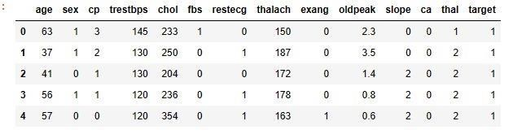
Results
_______________________________
Predict likelihood of heart disease using supervised ML.
Dataset sourced from UCI repository.
Dataset division into training and test sets.
Data pre-processing for cleaning and optimization.
Graphical representation of accuracy scores.
Comparison with scores from other studies.
Contributes to ML techniques in cardiovascular health prediction (Shah, 2020).
Algorithm | Accuracy Score
Naïve Bayes | 85.25%
Decision Tree | 81.97%
Logistic Regression | 85.21%
Random Forest | 95.08%
______________________________

Slide 9
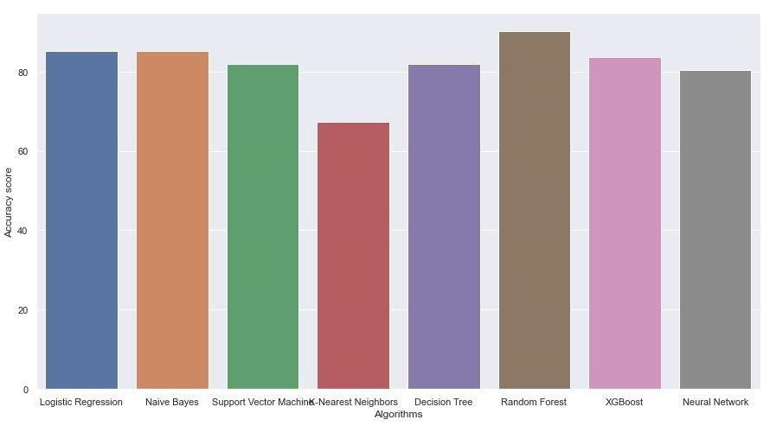
Results
_______________________________
Naïve Bayes, decision tree, random forest, K-nearest neighbor.
Employed Naïve Bayes, decision tree, K-nearest neighbor, and random forest.
Implemented algorithms in Python.
Proposed model shows promise with comparable or superior accuracy.
______________________________

Slide 10
Conclusion
_______________________________
Explored diverse classifiers: Decision Tree, Naive Bayes, Logistic Regression, SVM, and Random Forest.
Proposed Ensemble Classifier: Leveraging strong and weak classifiers for heightened predictive accuracy.
Alarming Rise in Heart Diseases: WHO statistics and Global Burden of Disease Report highlight the critical need for accurate prediction and early intervention.
Economic Burden: Underscores urgency for innovative solutions in cardiovascular healthcare.
Tool Integration: Utilizing various tools and libraries for model development and assessment.
Dataset Source: UCI Machine Learning repository with 300 examples and 14 attributes.
Sequential Process: Data cleaning, transformation, integration, reduction, classification, splitting, and algorithm application.
Naïve Bayes: Simple and efficient but relies on independence assumptions.
Decision Tree: Interpretable model with potential for overclassification.
K-nearest neighbor: Simple yet sensitive to irrelevant features.
Random Forest: High accuracy with an ensemble approach but requires substantial data.
_______________________________

Slide 11
References
_______________________________
Ke, G. Q.-Y. (2017). Lightgbm: A highly efficient gradient boosting decision tree. Advances in neural information processing systems.
Mohanty, S. N. (2020). . Recommender system with machine learning and artificial intelligence: practical tools and applications in medical, agricultural and other industries. John Wiley & Sons.
Pedregosa, F. G. (2011). Scikit-learn: Machine learning in Python. the Journal of machine Learning research , 2825-2830.
Rindhe, B. U. (2021). "Heart disease prediction using machine learning.". Heart Disease.
Shah, D. S. (2020). Heart disease prediction using machine learning techniques. SN Computer Science, 1-6.
Sidey-Gibbons, J., & Chris J., S.-G. (2019). Machine learning in medicine: a practical introduction. BMC medical research methodology, 1-8.
Singh, A. a. (2020). Heart disease prediction using machine learning algorithms. international conference on electrical and electronics engineering (ICE3),, 452-457.
_______________________________

Slide 12
_______________________________
THANK YOU
_______________________________

